Slide 1
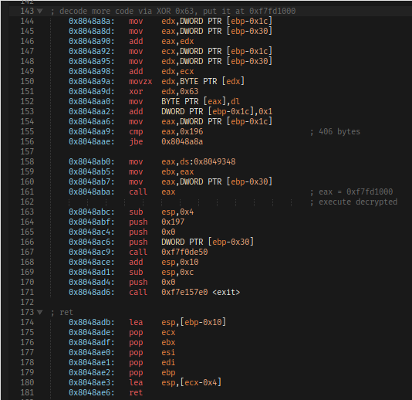
Introduction to x86 Assembly
By Christian Marinkovich

Slide 2
Workshop Overview
What is x86 Assembly?
Assembly vs High level language
Registers
Memory
Basic Instructions
Conditional Jumps & Comparisons
Syscall, Call, and Ret
The Stack
NASM Assembly Sections
Live Coding Demo
Conclusion & Questions

Slide 3
What is x86 Assembly?
What is Assembly Language?
A low-level programming language
Human readable instructions representing machine instructions
Direct access to CPU registers
What is x86 Assembly?
x86 is an instruction set architecture or ISA
Human readable programming language for writing instructions for processors implementing that architecture
x86-64 = 64 bit extension of that architecture -> we will focus on this today

Slide 4
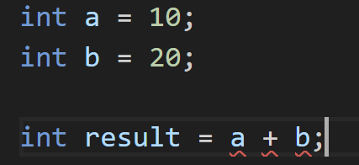
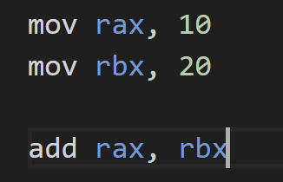
Assembly vs. High Level Language
High Level Language:
Uses variables
Uses operators (+,-,/,*)
Easier to read and write
Abstracts hardware details
Assembly Language:
Uses registers and memory
Uses raw instructions (ADD, SUB)
More explicit and detailed
Exposes hardware details
High Level Language
Assembly Language

Slide 5
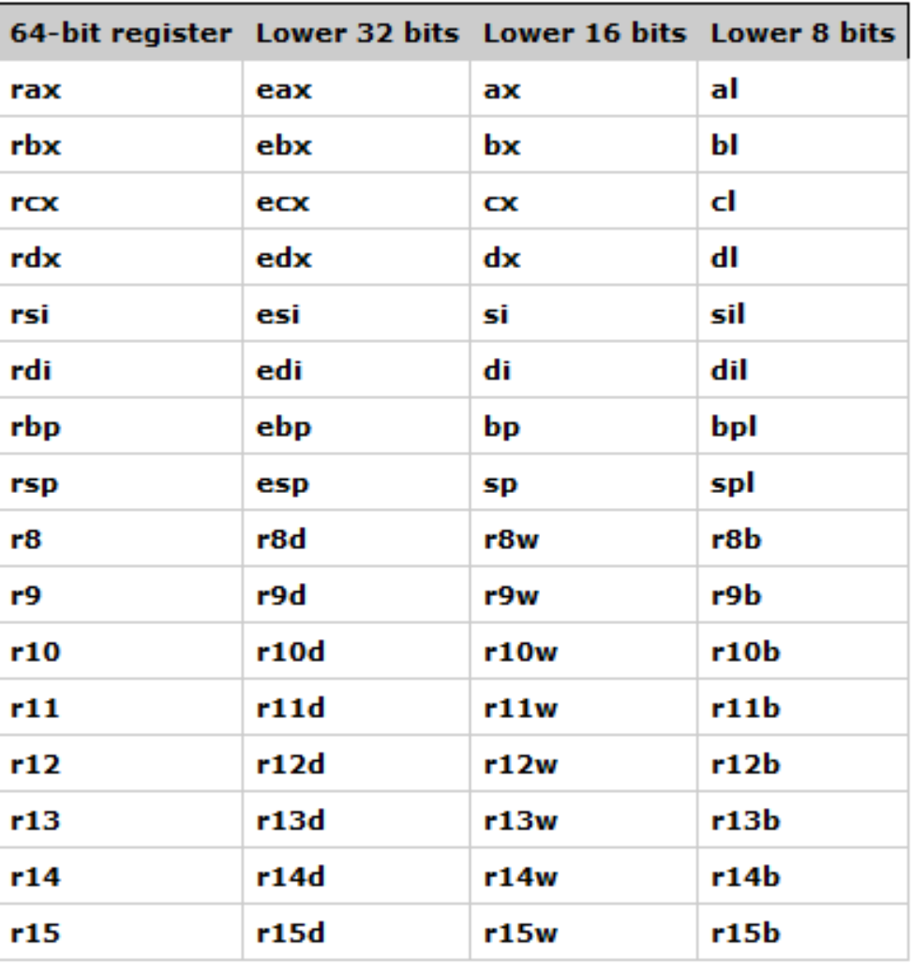
Registers
Registers are small and extremely fast storage locations inside the CPU
They can hold data, addresses, and temp data
Used by assembly instructions to perform operations
X86-64 has 16 of these general-purpose registers
Notes:
al = lower 8 bits of ax = lower 16 bits of eax = lower 32 bits of rax

Slide 6
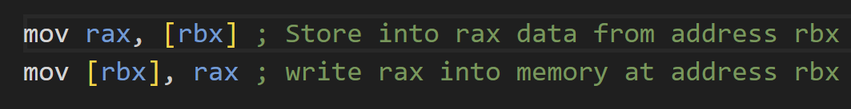
Memory
Has larger capacity than registers, but slower access
[] – Indicate accessing a value stored at a memory address
Registers can hold values OR memory addresses
Instructions can transfer data between registers and memory
X86-64 supports the following operations:
  Byte (8-bit)
  Word (16 bit)
  Doubleword (32 bit)
  Quadword (64 bit)

Slide 7
Basic Instructions
Instruction | Purpose | Example
MOV | Copy data | mov rax, 10
ADD | Addition | add rax, rbx
SUB | Subtraction | sub rax, rbx
IMUL | Multiplication | imul rax, rbx
INC | Increment by 1 | inc rax
DEC | Decrement by 1 | dec rax
XOR | Bitwise XOR | xor rax, rax
AND | Bitwise AND | and rax, rbx
OR | Bitwise OR | or rax, rbx
Notes:
All can accept immediate values and register values as second input

Slide 8

Conditional Jumps & Comparisons
Comparisons:
Checks if two registers are equal by subtracting them
Sets ZF = 1 if result is 0 (Meaning they are equal)
Updates other flags in RFLAGS too
Jump instructions check this flag
Instruction | Purpose | Example
JE / JZ | Jump if equal / zero | je equal
JNE / JNZ | Jump if not equal/zero | jne not_equal
JG | Jump if greater (signed) | jg greater
JL | Jump if less (signed) | jl less
JGE | Jump if greater than or equal (signed) | jge greater_equal
JLE | Jump if less than or equal (signed) | jle less_equal
JA | Jump if above (unsigned) | ja above
JB | Jump if below (unsigned) | jb below
JMP | Unconditional Jump | jmp unconditional

Slide 9
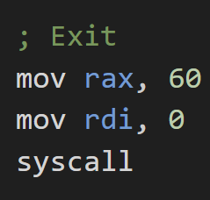


Syscall, Call, and Ret
SYSCALL:
rax – system call number (EX: 0 for read)
rdi – 1st argument
rsi – 2nd argument
rdx – 3rd argument
rax – Return value
CALL and RET:
rdi – 1st argument
rsi – 2nd argument
rdx – 3rd argument
rax – return value for CALL

Slide 10
The Stack
Region in memory to store temp data during program execution
LIFO (Last In First Out)
Grows toward lower memory addresses in x86-64
Registers:
RSP – Stack Pointer
  Points to the top of the current stack
  sub rsp, <size> to allocate space
RBP – Base Pointer
  Points to the base of the stack and used as a reference point
Instruction | Purpose | Example
PUSH | Places a value onto the stack | push rax
POP | Removes top value from stack | pop rbx
CALL | Push return address and jump to function | call my_function
RET | Pops return address and returns to caller | ret

Slide 11
NASM Assembly Sections
Section | Purpose | Example
.data | Stores initialized data | section .data
.bss | Reserves space for uninitialized data | section .bss
.text | Contains program instructions | section .text
global | Makes symbol accessible to linker | global _start
db | Define byte-sized data | message db “Hello”
resb | Reserves bytes of memory | buffer resb 64
equ | Defines a constant | length equ 10
Notes:
global is used to define program entry point

Slide 12
Live Coding Demo!

Slide 13
First, Get set up
https://embedenv.com/online-compiler/assembly
Or try this one: https://app.x64.halb.it/
Or, if neither online assembly works, you can install one with WSL:
sudo apt update
sudo apt install nasm build-essential
Then, run your program with:
nasm -f elf64 -g -F dwarf example.asm -o example.o
ld -o example example.o
./example
Template can be found at: https://github.com/Christian2147/x86-Assembly-Workshop

Slide 14
Thank you!!!
Any Questions?

